Slide 1
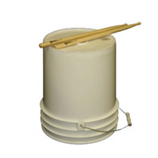
INTRODUCTION TO BUCKET DRUMMING
Basic Drumming Techniques

Slide 2
CARE OF YOUR BUCKET AND DRUMSTICKS
You will all be assigned a specific bucket and pair of drumsticks
You may NOT share your bucket and/or drumsticks with another student
The bucket will be stored in your room
The drumsticks can be kept in your backpack so you can practice at home but they MUST BE BROUGHT BACK TO SCHOOL THE DAYS YOU HAVE MUSIC CLASS! (No drumsticks…no drumming!)
The bucket can take a lot of drumming but if you hit it too hard, IT WILL BREAK! There is no need to always play your drum forte (loudly)—in other words…RESPECT YOUR BUCKET AND DRUMSTICKS!

Slide 3
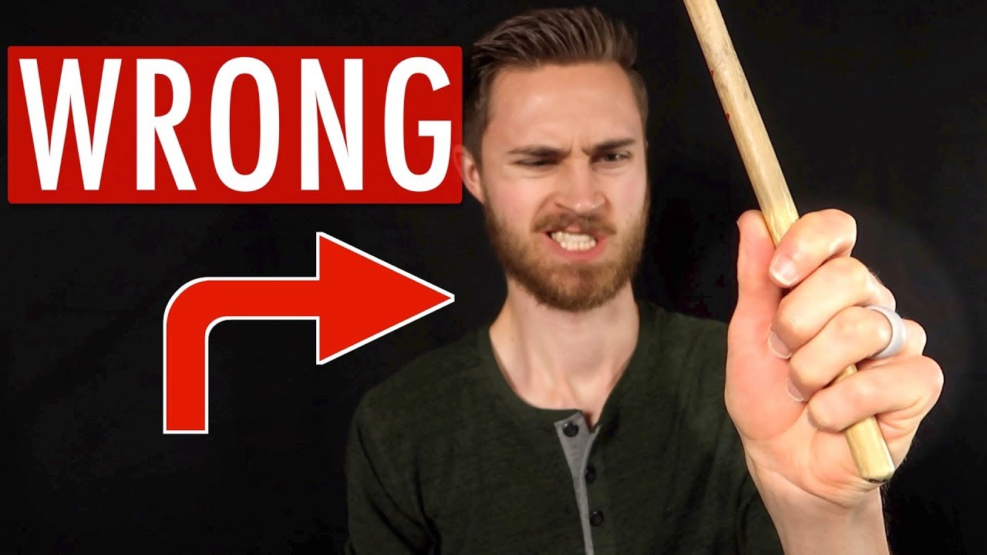
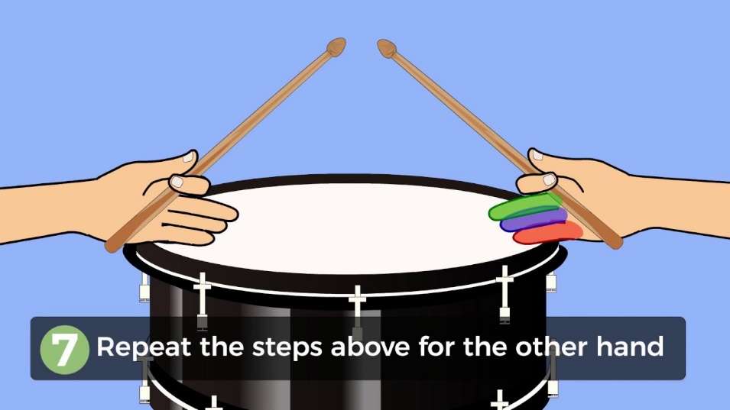
HOW TO HOLD THE DRUMSTICKS (Matched Grip)
Do NOT grip the drumsticks like this:
Instead, grip the drumsticks like this:
Bucket Drumming students must learn to use both their Right Hand (“R”) and Left Hand (“L”) when drumming!

Slide 4
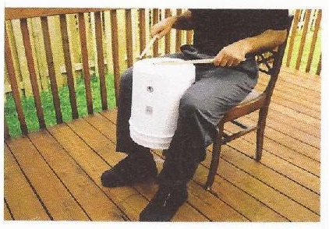
HOW TO POSITION THE BUCKET
Sit up with good posture—your back should be straight. Don’t slouch!
The bucket is held in between your knees and thighs
The bucket should be about 8 to 10 cm above the top of your thighs
The bucket should be angled slightly towards you so that you can strike the centre of the bucket with your drumsticks (usually)

Slide 5
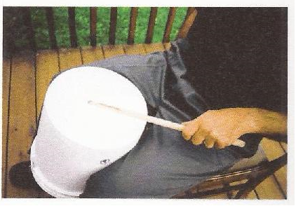
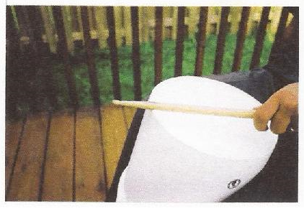
DIFFERENT BUCKET DRUMMING TECHNIQUES
Hitting the centre of the bucket
Hitting the rim of the bucket

Slide 6
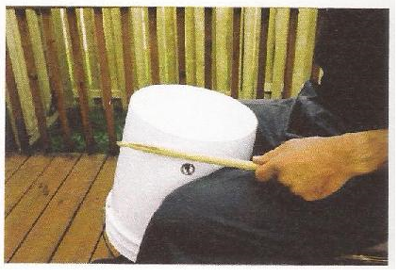
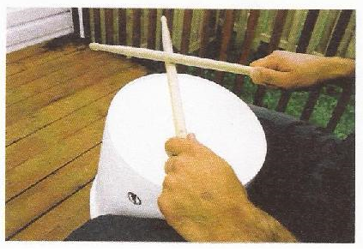
DIFFERENT BUCKET DRUMMING TECHNIQUES
Hitting the side of the bucket
Hitting the drumsticks together
(called a stick click)

Slide 7
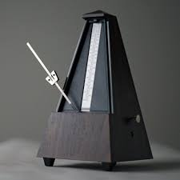
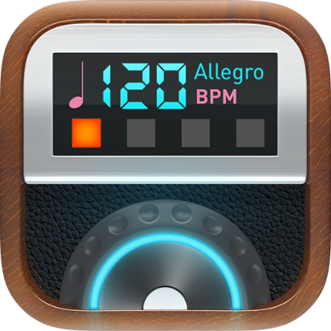
WHAT IS A “METRONOME”? (And why you need one)
A metronome is a device used by all musicians to keep a steady beat when practicing (either in Music class or at home)
Metronomes used to look like this:
(and you can still buy them, but…)
Today, most musicians download a metronome app for their devices, like this:
The beat is measured in “Beats Per Minute” or “BPM”
The higher the number, the faster the beat!
SO DOWNLOAD A METRONOME APP!

Slide 8
WHAT IS A TIME SIGNATURE?
A time signature is a set of numbers you see at the beginning of piece of music
These numbers look like a fraction (without the line in between)
The top number tells you how many beats there are in every bar
The bottom number tells you what kind of note gets one beat
The most common time signature is 4/4 time
¦¼
This number tells you there are 4 beats in a bar
This number tells you the quarter note ( ± ) gets one beat

