Slide 1
Bucket Drumming Techniques Quiz
Can you hit the correct part of the bucket?
In the next 20 slides you will see the notation for hitting either the:
Centre of Bucket (bottom space)
Edge of Bucket (3rd space)
Stick Click (4th space)
Side of Bucket (above top line)
As soon as you see the whole note, hit the correct part of the drum.
Mr. Skinner will reveal the answer after everyone has played.
Good luck!

Slide 2
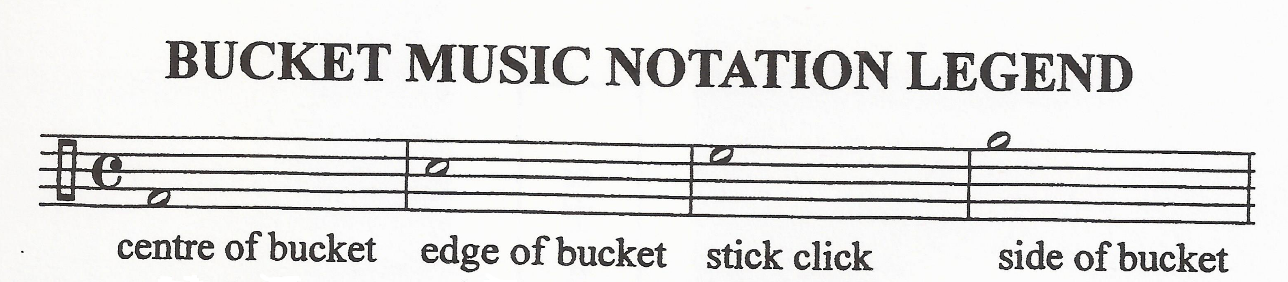
Here are the techniques...one last time!

Slide 3
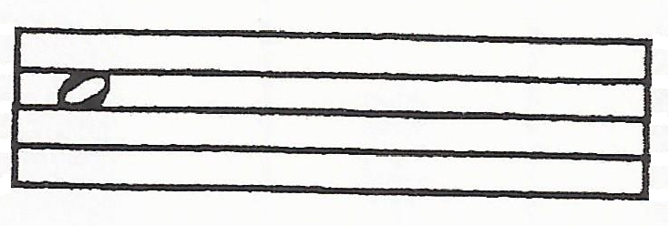
1. Hit the correct part of the bucket for...
Edge of Bucket

Slide 4
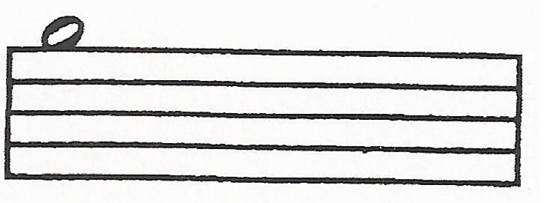
2. Hit the correct part of the bucket for...
Side of Bucket

Slide 5
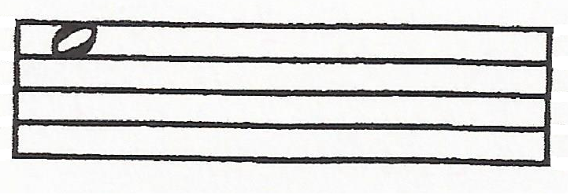
3. Hit the correct part of the bucket for...
Stick Click

Slide 6
4. Hit the correct part of the bucket for...
Stick Click

Slide 7
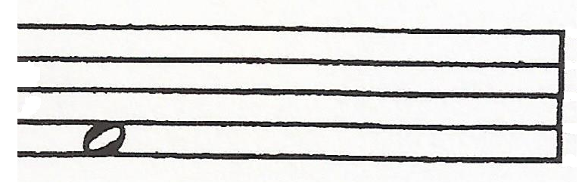
5. Hit the correct part of the bucket for...
Centre of Bucket

Slide 8
6. Hit the correct part of the bucket for...
Side of Bucket

Slide 9
7. Hit the correct part of the bucket for...
Edge of Bucket

Slide 10
8. Hit the correct part of the bucket for...
Stick Click

Slide 11
9. Hit the correct part of the bucket for...
Edge of Bucket

Slide 12
10. Hit the correct part of the bucket for...
Stick Click

Slide 13
11. Hit the correct part of the bucket for...
Edge of Bucket

Slide 14
12. Hit the correct part of the bucket for...
Stick Click

Slide 15
13. Hit the correct part of the bucket for...
Centre of Bucket

Slide 16
14. Hit the correct part of the bucket for...
Side of Bucket

Slide 17
15. Hit the correct part of the bucket for...
Edge of Bucket

Slide 18
16. Hit the correct part of the bucket for...
Centre of Bucket

Slide 19
17. Hit the correct part of the bucket for...
Stick Click

Slide 20
18. Hit the correct part of the bucket for...
Centre of Bucket

Slide 21
19. Hit the correct part of the bucket for...
Stick Click

Slide 22
20. Hit the correct part of the bucket for...
Edge of Bucket

