Slide 1
Bucket Drumming Rhythms Quiz
Can you play the correct rhythms?
Each of these 30 slides will contain one individual rhythm.
When you see the rhythm on the SMARTBoard, you will be asked to play the correct rhythm on the centre of the drum.
Use the words you learned to play the correct rhythms.
Wait for Mr. Skinner to count you in, then play the rhythm you see.
Once everyone has had a chance to play the rhythm, the correct answer will be revealed.

Slide 2
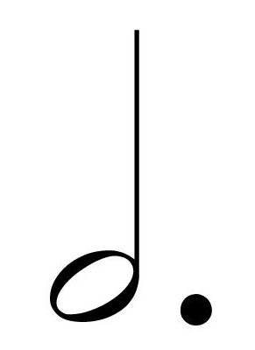
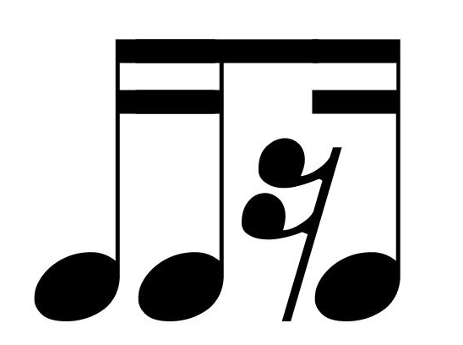
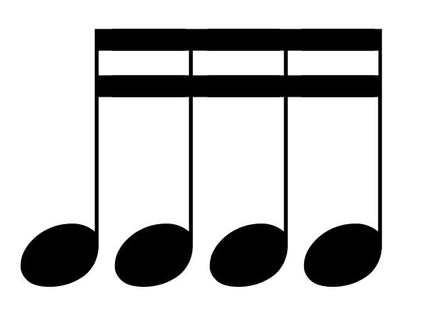
Here are the rhythms...one last time!
pie
piz-za
half note
great big whole note
half note dot
al - li - ga- tor
pop bot - tle
bi - cy cle
tim - ka
al - li - (ga)- tor

Slide 3
1. Play the correct rhythm for...
bi - cy cle

Slide 4
2. Play the correct rhythm for...
half note dot

Slide 5
3. Play the correct rhythm for...
half note

Slide 6
4. Play the correct rhythm for...
great big whole note

Slide 7
5. Play the correct rhythm for...
piz - za

Slide 8
6. Play the correct rhythm for...
al – li – ga - tor

Slide 9
7. Play the correct rhythm for...
piz - za

Slide 10
8. Play the correct rhythm for...
al - li - (ga) - tor

Slide 11
9. Play the correct rhythm for...
al – li – ga - tor

Slide 12
10. Play the correct rhythm for...
tim - ka

Slide 13
11. Play the correct rhythm for...
pop bot - tle

Slide 14
12. Play the correct rhythm for...
pie

Slide 15
13. Play the correct rhythm for...
pop bot - tle

Slide 16
14. Play the correct rhythm for...
bi - cy cle

Slide 17
15. Play the correct rhythm for...
al – li – ga - tor

Slide 18
16. Play the correct rhythm for...
pie

Slide 19
17. Play the correct rhythm for...
half note dot

Slide 20
18. Play the correct rhythm for...
bi - cy cle

Slide 21
19. Play the correct rhythm for...
half note

Slide 22
20. Play the correct rhythm for...
pie

Slide 23
21. Play the correct rhythm for...
al – li – ga - tor

Slide 24
22. Play the correct rhythm for...
great big whole note

Slide 25
23. Play the correct rhythm for...
piz - za

Slide 26
24. Play the correct rhythm for...
al – li – ga - tor

Slide 27
25. Play the correct rhythm for...
al - li - (ga) - tor

Slide 28
26. Play the correct rhythm for...
pop bot - tle

Slide 29
27. Play the correct rhythm for...
pie

Slide 30
28. Play the correct rhythm for...
piz - za

Slide 31
29. Play the correct rhythm for...
half note

Slide 32
30. Play the correct rhythm for...
al – li – ga - tor

