Slide 1
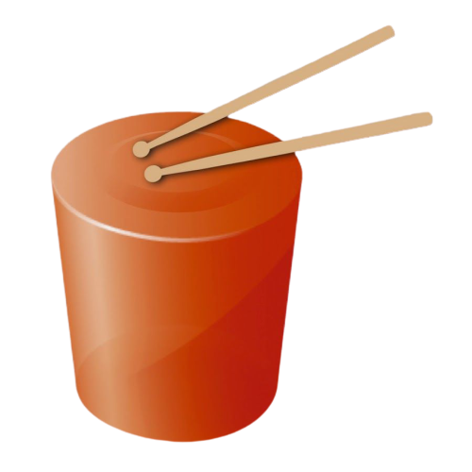
BUCKET
DRUMMING KARATE
Important stuff you need and will use.
Good luck and have fun!
Click on the bucket for some fun grooves.

Slide 2
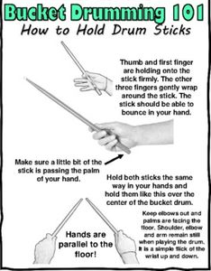
BUCKET DRUMMING RUBRIC
 | Level 1 | Level 2 | Level 3 | Level 4
Tempo | Lacked consistent tempo. | Tempo difficulties throughout performance. | Slight tempo imbalance during performance. | Steady tempo throughout entire performance.
Rhythm | Performance has many errors. | Several errors causing a disruption to the rhythmic flow. | Very few rhythmic inaccuracies; mistakes were not distracting to the overall composition. | All rhythm patterns were played without mistake and with confidence.
Posture and Sticking | Holding sticks incorrectly, slouched over bucket, and did not follow labelled sticking. | Holding sticks somewhat correct, posture is almost straight, followed some of the sticking. | Holding sticks properly, back is straight, followed proper sticking. | Holding sticks properly, back is straight, elbows are away from the body, followed sticking and articulations.

Slide 3
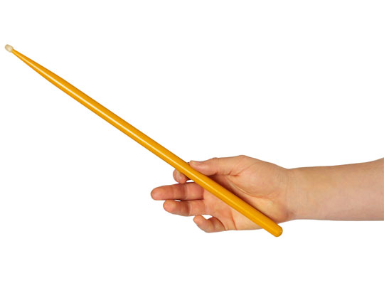
Proper Drumstick Grip

Slide 4
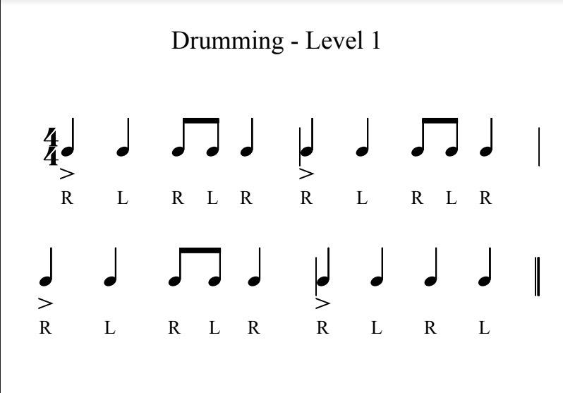
White Belt

Slide 5
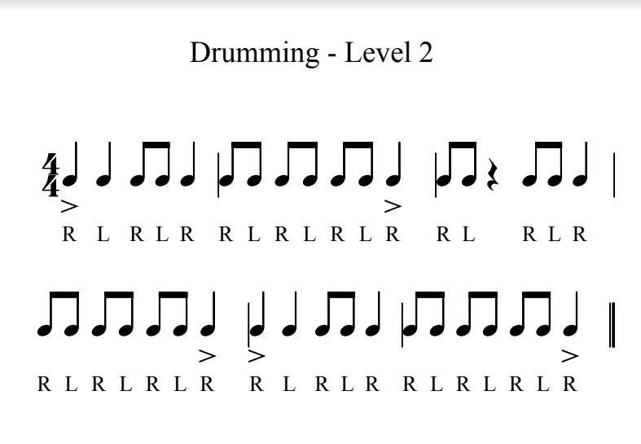
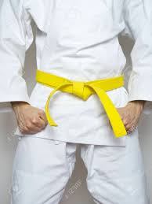
Yellow Belt
To exceed expectations, try drumming the accent notes on the rim.

Slide 6
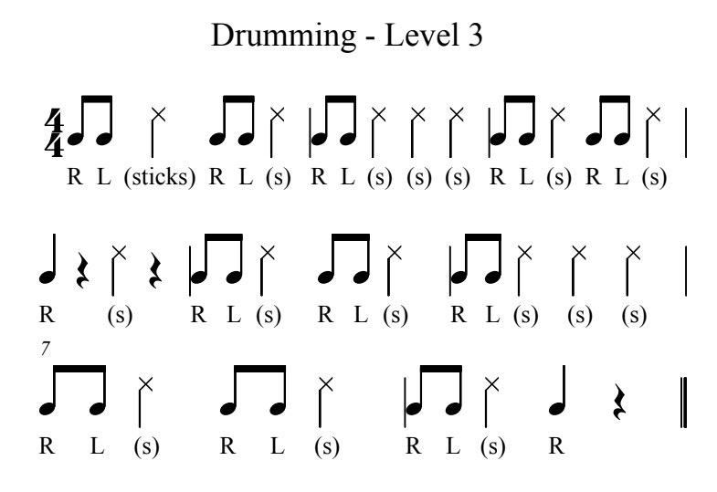
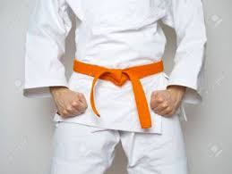
Orange Belt

Slide 7
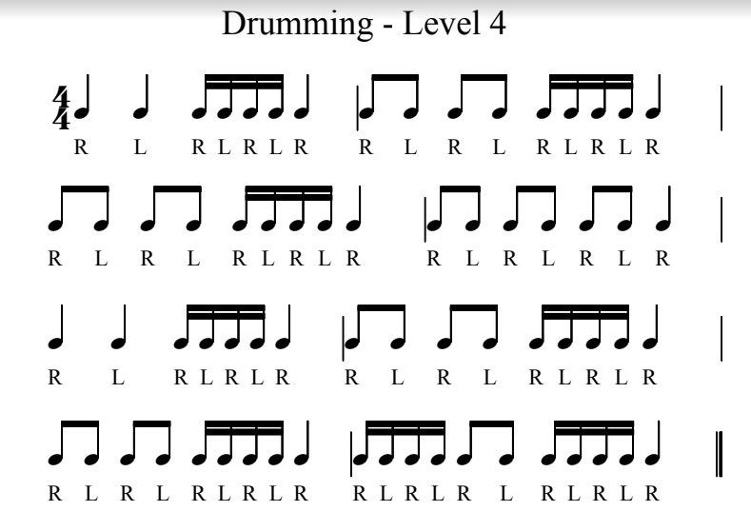
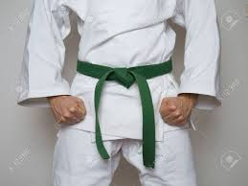
Green Belt
As an extension, begin the song at a mf marking, in m.5 come to a sudden piano dynamic and in the last measure play a subito forte.

Slide 8
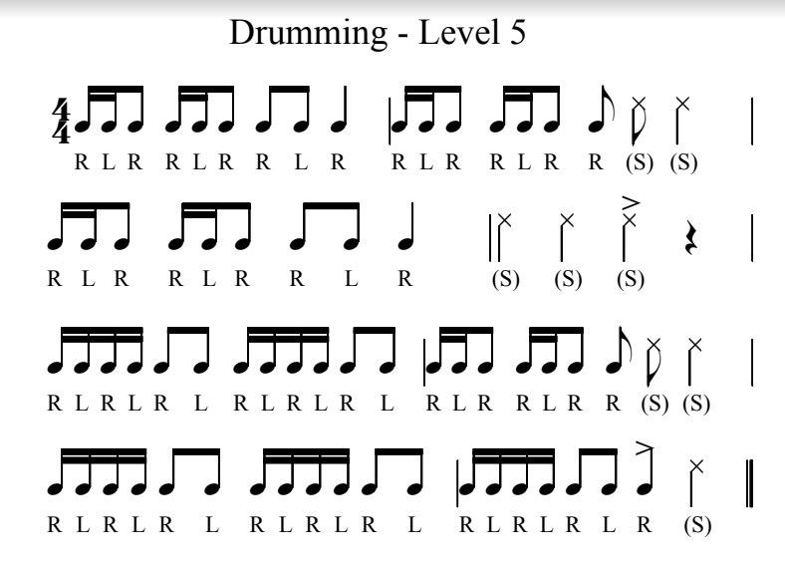
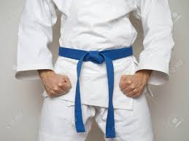
Blue Belt
At the end of measures 2,4,6,and 8, hit the side of the bucket.
The last measure use both sticks for the accented note.

Slide 9
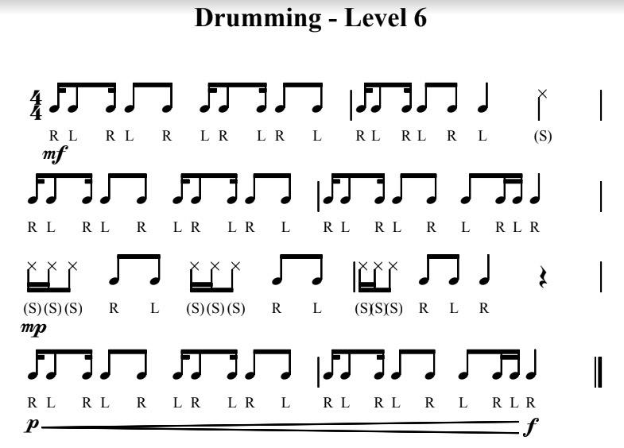
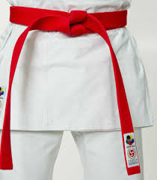
Red Belt
Start off slowly and make sure you pay attention to the sticking. When you are comfortable with that then add in the dynamics.

Slide 10
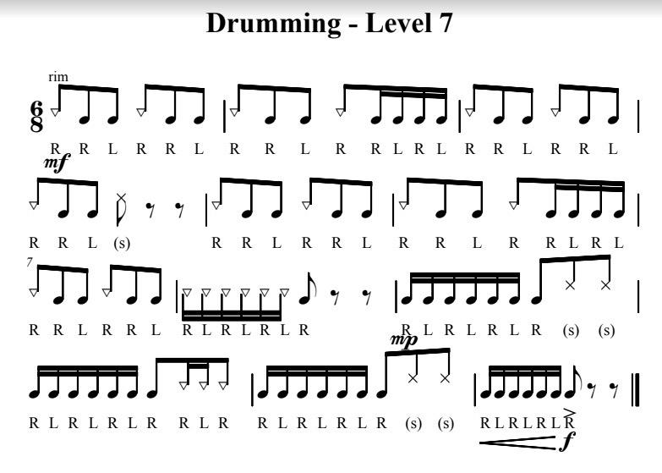
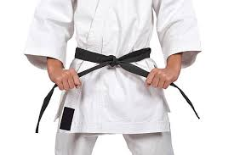
Black Belt
In the last measure, don’t forget to start at the top of the bucket and work your way to the centre for a great crescendo!

